Slide 1

I.D.L.E AN INTELLIGENT DEVICE FOR LESSENING EMISSIONS
Rohan, Isa, Jack, Eric, and Alex

Slide 2



The Problem: Idling
IDLING IS WHEN A CAR HAS ITS ENGINE RUNNING WITHOUT IT MOVING ANYWHERE
EACH YEAR IN THE US, 3 BILLION GALLONS OF FUEL ARE WASTED BY IDLING
26K-53K KILOTONS OF CO2 ARE EMITTED BY WASTED FUEL

Slide 3
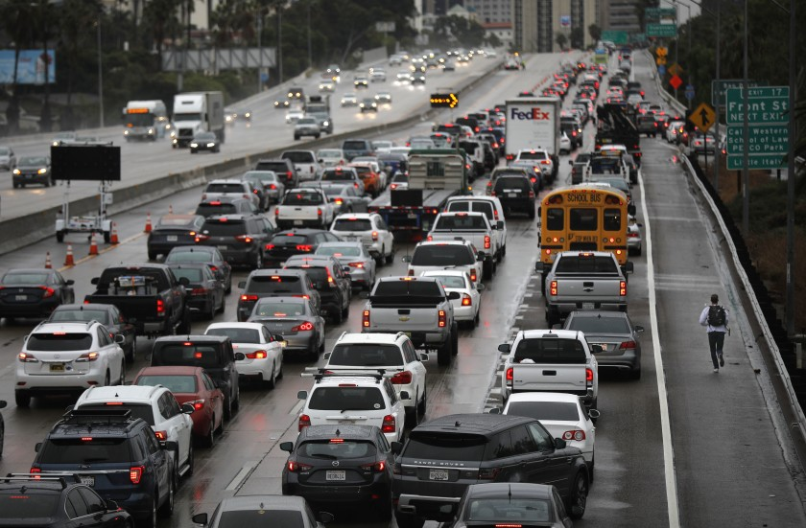
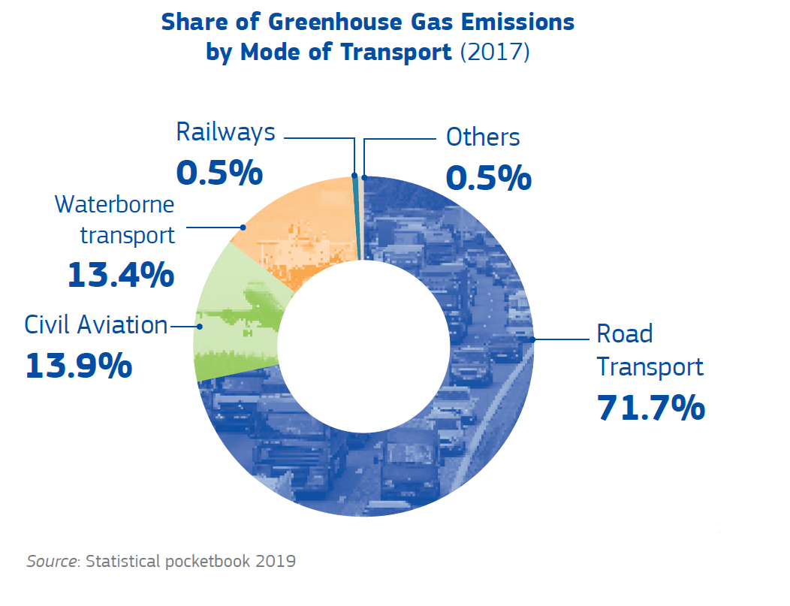
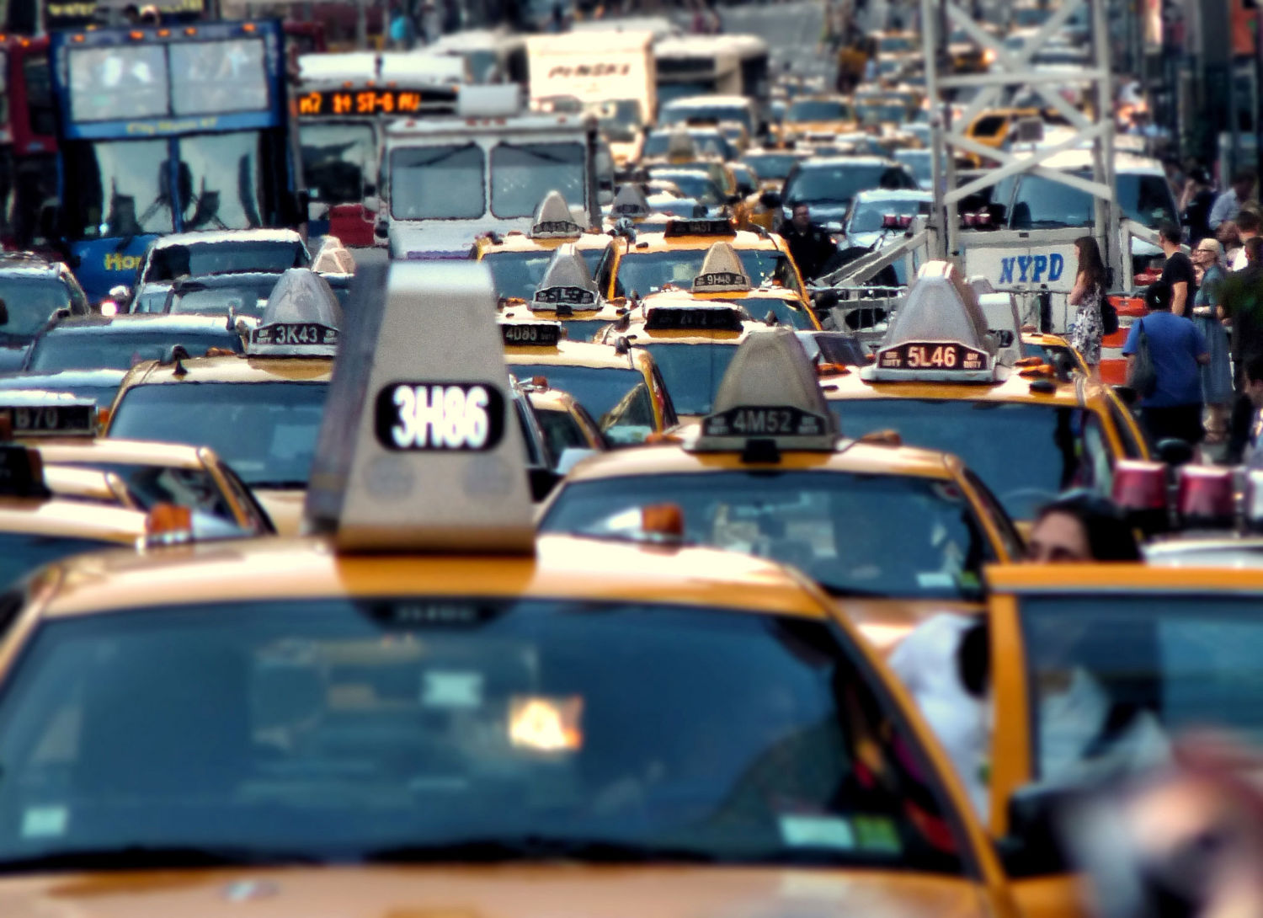

Slide 4
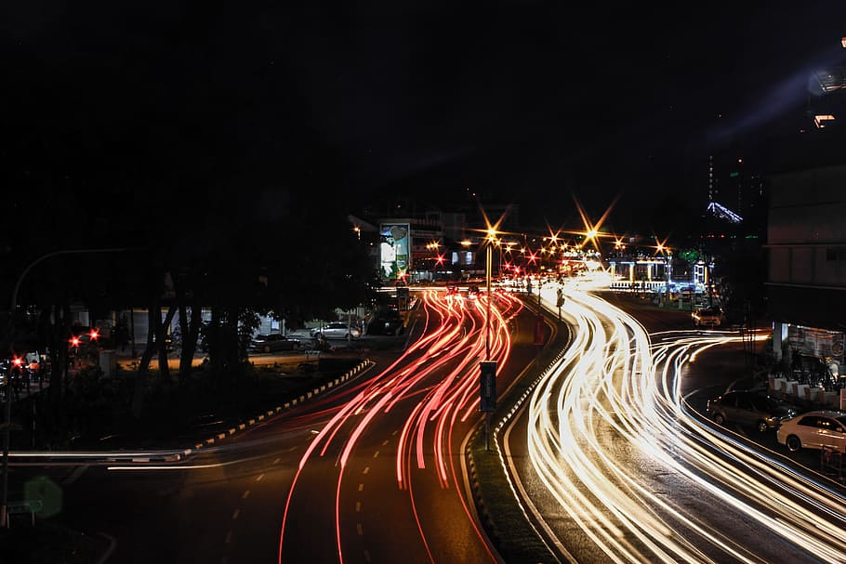
How can we fix this problem?
Intersections are one of the largest causes of unnecessary idling
At many intersections, you can wait for over five minutes
With a cheap AI powered camera, we can significantly decrease the wait time at intersections
Cars are detected idling in an intersection 🡪 stop light switches

Slide 5
Impact
Significantly reduced carbon emissions
Much faster travel times
Rural and suburban areas

Slide 6
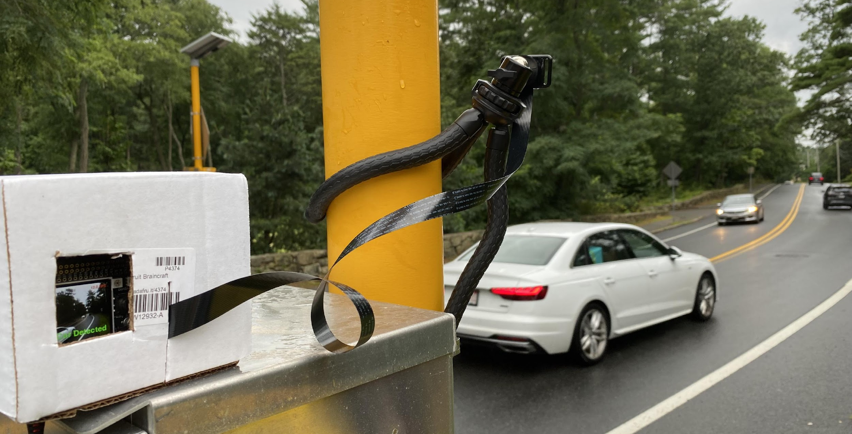
DEMO
https://youtu.be/ERxGI-QPPlQ

Slide 7
SETBACKS
01
02
03
The camera must be taught each intersection manually
Does not currently work in dark environments
Requires 2 cameras for a single 4-way intersection

Slide 8
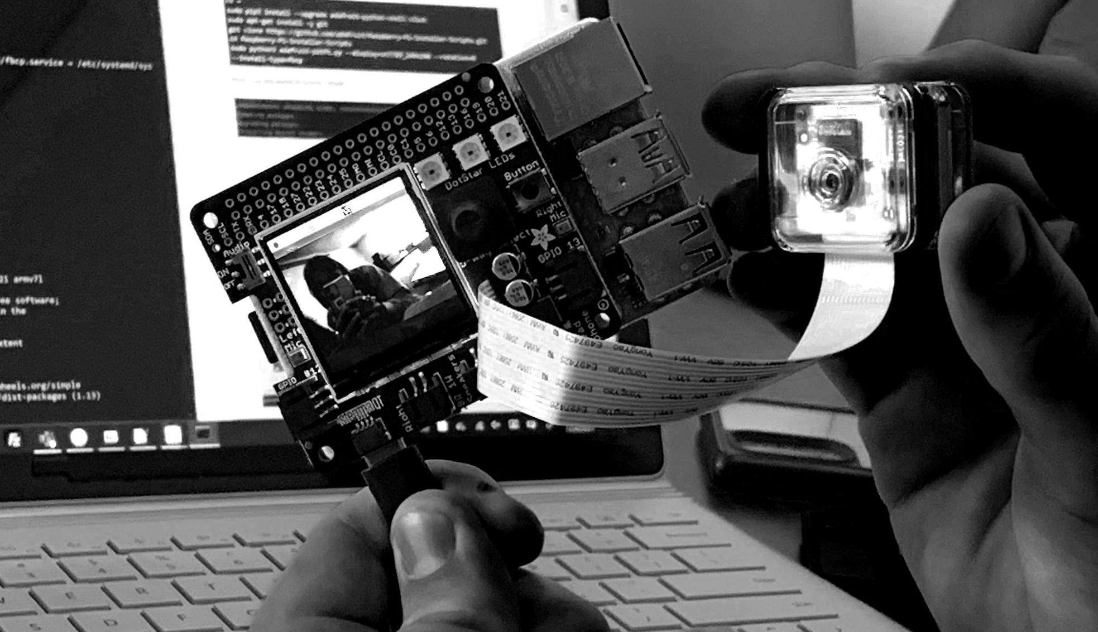
COST OF IMPLEMENTATION
Our Solution
Existing Solutions
CAMERA SYSTEM: $150
MOUNTING HARDWARE: $10
LABOR COST: $300
TOTAL: $620 PER 4-WAY INTERSECTION
Standard Camera: $20k
Existing Smart Cameras: $30—60K

Slide 9
WORKS CITED
Gaines, L., et al. “Which Is Greener.” US Department of Energy.
Berman, B., et al. “Smart tech revolutionizing the traffic light” Society of Automotive Engineers
Climate Change Connection: Problems Caused by Idling
Argonne National Laboratory

